Slide 1
Machine Learning
Presented by: Furqan Jan
Artificial Intelligence

Slide 2
What is Artificial Intelligence?
Artificial Intelligence (AI) is a branch of computer science that focuses on creating machines and computer systems that can perform tasks that normally require human intelligence.
AI means making computers capable of performing intelligent tasks.
What can AI systems do?
Learn from information
See and recognize objects or images
Understand human language
Recognize speech and sounds
Make decisions
Solve problems
Make predictions

Slide 3
What is Machine Learning?
Machine Learning (ML) is a branch of Artificial Intelligence that allows computers to learn patterns from data and make predictions or decisions without being explicitly programmed for every situation.
Machine Learning means teaching a computer using data instead of giving it every rule manually.
Data → Learning → Model → Prediction
Data — Give examples to the computer.
Learning — The computer finds patterns in the data.
Model — The learned patterns are stored in a model.
Prediction — The model uses what it learned to make predictions on new data.

Slide 4
Example
House Data
Size + Rooms + Location
↓
Machine Learning Model
↓
Predicted House Price
Key Point
Machine Learning allows computers to learn from data and improve their predictions.

Slide 5
Why do we need Machine Learning?
Machine Learning is needed because many real-world problems are too complex to solve using manually written rules.
Why ML?
Large amounts of data — Humans cannot analyze huge datasets manually.
Find hidden patterns — ML can discover patterns in data.
Automate decisions — Systems can make predictions automatically.
Handle changing situations — Models can learn from new data.
Make predictions — ML can predict future or unknown outcomes.

Slide 6
Traditional Programming vs Machine Learning
Traditional Programming | Machine Learning
Programmer writes the rules | Model learns patterns from data
Rules + Data → Output | Data + Output → Model
Rules are explicitly defined | Rules are learned automatically
Works well when rules are clear | Useful when rules are complex or difficult to define

Slide 7
Real-world applications of ML
Machine Learning is used in many areas of our daily lives and different industries.
Healthcare — Disease detection and medical image analysis
Banking — Fraud detection and risk prediction
Email — Spam detection
E-commerce — Product recommendations
Smartphones — Face recognition and voice assistants
Transportation — Traffic and route prediction
Entertainment — Movie, music, and video recommendations
Cybersecurity — Detecting unusual or suspicious activity
Industry — Predictive maintenance and quality inspection

Slide 8
How Machine Learning works
Basic Process
1. Collect Data
Gather relevant examples.
⬇️
2. Prepare Data
Clean and organize the data.
⬇️
3. Train the Model
The model learns patterns from the data.
⬇️
4. Evaluate the Model
Check how well the model performs.
⬇️
5. Make Predictions
Use the trained model on new data.

Slide 9
Dataset
A dataset is a collection of data used by a machine learning system to learn pa
Main Parts of a Dataset
Rows → Individual examples or records
Columns → Different types of information
Features → Input information used by the model
Label / Target → The output we want to predict

Slide 10
House Price Dataset
Size | Bedrooms | Location | Price
1200 | 2 | Peshawar | 8M
1500 | 3 | Lahore | 12M
1800 | 4 | Islamabad | 18M

Slide 11
Features
Features are the input variables or characteristics in a dataset that a Machine Learning model uses to learn patterns and make predictions.
Size | Bedrooms | Location | Price
1200 | 2 | Peshawar | 8M
1500 | 3 | Lahore | 12M

Slide 12
Features (Input)
Features (Input):
Size
Number of bedrooms
Location
Target (Output):
Price
Simple Idea
Features → Model → Prediction

Slide 13
Labels / Target
Labels or Targets are the output values that a Machine Learning model is trained to predict.
Example: House Price Prediction
Size | Bedrooms | Location | Price
1200 | 2 | Peshawar | 8M
1500 | 3 | Lahore | 12M
1800 | 4 | Islamabad | 18M

Slide 14
Model
A Machine Learning Model is a system that learns patterns from data and uses those patterns to make predictions on new data.
How it works
Training Data → Model Learns Patterns → Prediction
Example: House Price Prediction
Features:
Size + Bedrooms + Location
↓
Trained ML Model
↓
Predicted Price

Slide 15
Training
Training is the process of teaching a Machine Learning model using data so that it can learn patterns and relationships.
How Training Works
Training Data → Model → Prediction → Compare with Actual Target → Improve Model
This process is repeated many times until the model learns useful patterns.
Example
For house price prediction:
House Features + Actual Prices
↓
Training
↓
Model learns the relationship
between house features and prices.

Slide 16
Prediction / Inference
Prediction is the process of using a trained Machine Learning model to produce an output for new data.
Inference is the term commonly used for the process of running new data through a trained model to get a prediction.
How it works
New Data → Trained Model → Prediction
Example: House Price Prediction
New House:
Size + Bedrooms + Location
↓
Trained ML Model
↓
Predicted Price: 15 Million PKR

Slide 17
Types of Machine Learning
Machine Learning is commonly divided into three main types:
1. Supervised Learning
The model learns from labeled data, where the correct answer is already provided.
Example: Predicting house prices or detecting spam emails.
2. Unsupervised Learning
The model learns from unlabeled data and finds patterns or groups on its own.
Example: Grouping customers based on their shopping behavior.
3. Reinforcement Learning
The model learns by interacting with an environment and receiving rewards or penalties.
Example: Training a robot to navigate or an AI to play a game.

Slide 18
Supervised Learning
Regression
Classification

Slide 19
Supervised Learning
Supervised Learning is a type of Machine Learning where a model learns from labeled data.
The training data contains both:
Features (Input) → information given to the model
Label / Target (Output) → the correct answer
How it works
Features + Correct Labels → Training → Model → Prediction
Example: House Price Prediction
Size + Bedrooms + Location → Price
The model studies many houses where the actual prices are already known and learns the relationship between the features and price.

Slide 20
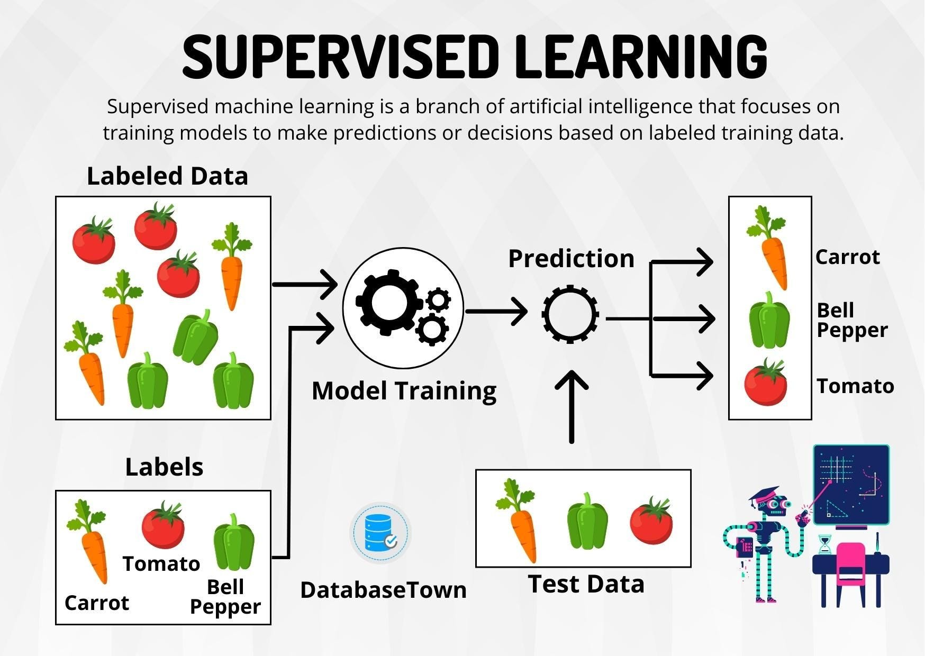
Example

Slide 21
Regression
Regression is a type of Supervised Learning used to predict a continuous numerical value.
Example
House Price Prediction
Features:
House size
Number of bedrooms
Location
↓
Regression Model
↓
Predicted Price: 15.5 Million PKR

Slide 22
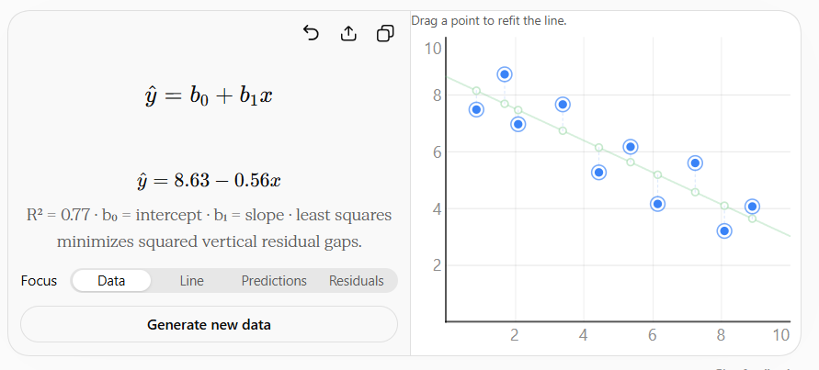
Regression

Slide 23
Classification
Classification is a type of Supervised Learning used to predict a category or class.
Example
Email Spam Detection
Features:
Email text
Sender
Links
Words used
↓
Classification Model
↓
Prediction:
Spam
Not Spam

Slide 24
Classification

Slide 25
Unsupervised Learning
Unsupervised Learning is a type of Machine Learning where a model learns from unlabeled data and finds patterns or structures on its own.

Slide 26
Learn by your own
Clustering
Dimensionality Reduction
Reinforcement Learning
Agent
Environment
Action
Reward

Slide 27
Machine Learning Workflow
Collecting data
Understanding a dataset
Data cleaning
Missing values
Categorical data
Encoding
Feature scaling
Feature selection
Training set
Testing set
Train/Test Split

